Slide 1
2012 Cross Country
Rule Changes
Editorial Changes
Points of Emphasis

Slide 3
CROSS COUNTRY COACH and OFFICIAL PREREQUESITES
Must have access to a 2012 NFHS T&F/CC Rule Book.
Must have knowledge of rules applicable to cross country competition.
Must have a throughout understanding of the cross country rule: Rule 9. (pgs. 66-75)

Slide 4
PIAA MODIFICATIONS OF RULE 9
No modified scoring in any meet. You must have a minimum of five teammates finish to score as a team.
Rule 9-6 (uniform) modifications:
Excludes watches (considered jewelry)
Excludes sunglasses (except verified prescription)
Excludes hats/head coverings (except by PIAA Executive Director authorization)
Excludes bracelets and wristbands (except medical)
Includes unadorned “scrunchies” and headbands not to exceed 2”, be of a soft material, a single color and be logo compliant
All team members must wear same color and design uniforms.
Use of an ineligible competitor results in a meet forfeit.

Slide 5
2012 RULE REVISIONS
The next 5 slides address the rule changes in cross country (Rule 9) for 2012.
Notes:
Administrative duties for the meet referee may need to continue after the contest to document actions which occur during the competition.
This revision illustrates the difference between the meet referee’s jurisdiction during the competition and other administrative responsibilities such as submitting specific reports after the competition is completed.
In addition, clarifies that state associations may continue to develop and implement policies that allow for review of unusual incidents that occur while the meet referee has jurisdiction or after the competition is completed.

Slide 6
Cross Country Course Rule 9-1-1
The cross country course shall be 2,500 to 5,000 meters (1.5 to 3.1 miles) in length, as determined by the games committee.
Measurement of the course shall be along the shortest possible route a runner may take.
Notes:
This method of measurement is a more accurate distance of the running route taken by competitors.
Updates the rule to the more current, acceptable trends of the sport for measuring the course.

Slide 7
Cross Country – Computerized Transponders and Chips Rules 9-3-3, 9-6-2
The finish of a cross country race may be recorded by computerized transponders/chips
When used:
A bib transponder or two computerized chips (one attached to each shoe) must be used for recording the finish
The official order of finish for the runners is that recorded by the transponders/chips
Competitors shall wear the assigned computerized transponders/chips unaltered for the purposes of official timing and place finish.
Notes:
This change clarifies that a computerized bib transponder is also allowed for timing and place finishes.
When worn on the shoes, one transponder/chip is to be worn on each shoe.
Both an official number and transponder may be assigned to each competitor.
Both shall be worn as assigned and unaltered.

Slide 8
Cross Country – Computerized Transponders and Chips Rules 9-3-3, 9-6-2
The bib transponder combines the chip into the bib start number
Competitors only have to attach the bib to their chest

Slide 9
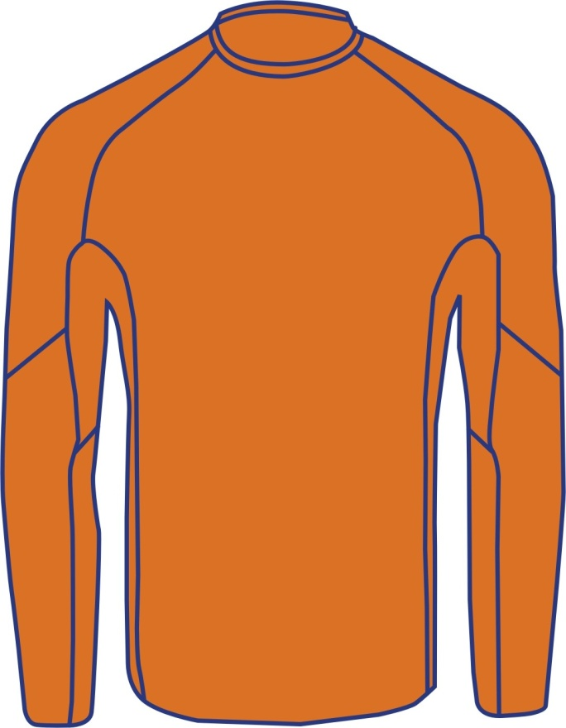
Visible Undergarment Rules 9-6-1b Notes: 3, 9-6-1c Notes: 3
Visible undergarments displaying seams stitched on the outside of the garment in a visible contrasting color to the single, solid color of the undergarment and function as actual seams for garment construction are legal.
Legal Visible Undergarment
Notes:
Stitching of a contrasting color on the visible undergarment does not distract or cause confusion.
The stitching must be used for actual construction of the garment and not for design purposes.

Slide 10
Competitor’s Uniform – Jewelry Rule 9-6-3, Penalty
The penalty for wearing jewelry applies only to the competitor involved.
When a meet official observes a competitor wearing jewelry, the official shall:
require the competitor to remove the jewelry (if prior to competition)
issue a warning that a subsequent violation during the event shall result in a disqualification.
The referee shall be notified of the violation by the observing official and he/she shall notify the competitor’s coach of the violation and warning.
Notes:
The wearing of jewelry is prohibited.
The penalties for a violation of Rules 4-3-3 and 9-6-3 now apply only to the competitor involved.
Without holding up competition, jewelry should be removed.
If it can’t be removed, the competitor should not compete until legal.
If a competitor is observed during competition of a violation, the same process of no further competition until legal, warning or disqualification if a subsequent offense applies.
The protocol for communication of a violation should be established by the officials before the meet begins.

Slide 11
2012 Cross Country
Major Editorial Changes

Slide 12
Editorial Changes
Rules 9-6-1, 2 Penalty and 9-6-4 Penalty: Corrects a clerical error and clarifies the disqualification is from the event meet.
Rule 9-4-2: Clarifies the referee has the authority to deal with “other irregularities” such as in timing or other unusual circumstances.

Slide 13
2012 Track and Field and Cross Country
Points of Emphasis

Slide 14
Points of Emphasis Starter Positions
Starters and assistant starters must be positioned to fairly observe the start of each race
The type of race and physical layout of facility will determine appropriate positioning
The starter and assistant starter should be positioned to minimize unnecessary exposure to the report of the starting device by competitors, officials and spectators

Slide 15
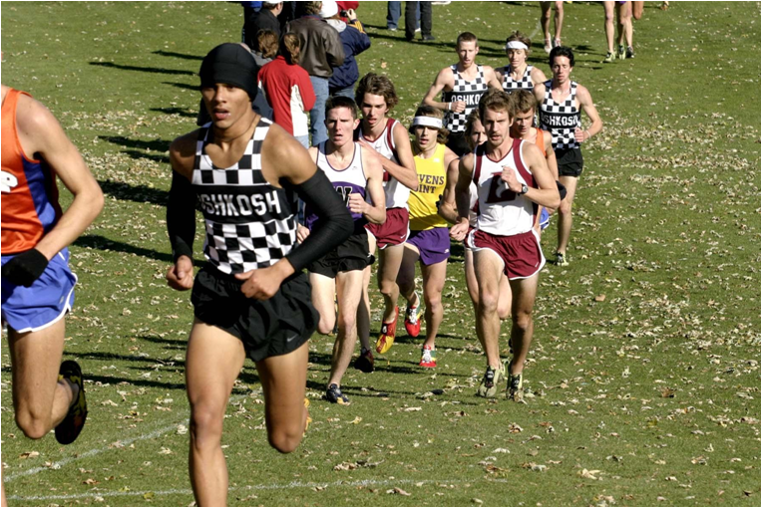
Points of Emphasis Jewelry and Uniforms Compliance Responsibilities
It is the Coach’s responsibility to make certain all competitors are in legal uniforms and are not wearing jewelry.
Athletes must be educated relative to the rules and their application before competing.
The coach has responsibility, along with the competitors, to be certain all are in legal uniform and wearing no jewelry.
The coach confirms with referee all competitors are in legal uniform and wearing no jewelry at the pre-meet meeting.

Slide 16
Points of Emphasis Jewelry and Uniforms Compliance Responsibilities
Officials serve two roles
Preventive role – make every effort to monitor illegal uniforms or wearing of jewelry to ensure they are made legal or removed before competition and when feasible, before the “warning” penalty.
Enforcer role – issue warnings and disqualifications when competitors are not in rule compliance – ultimate responsibility belongs to coach and competitors.

Slide 17
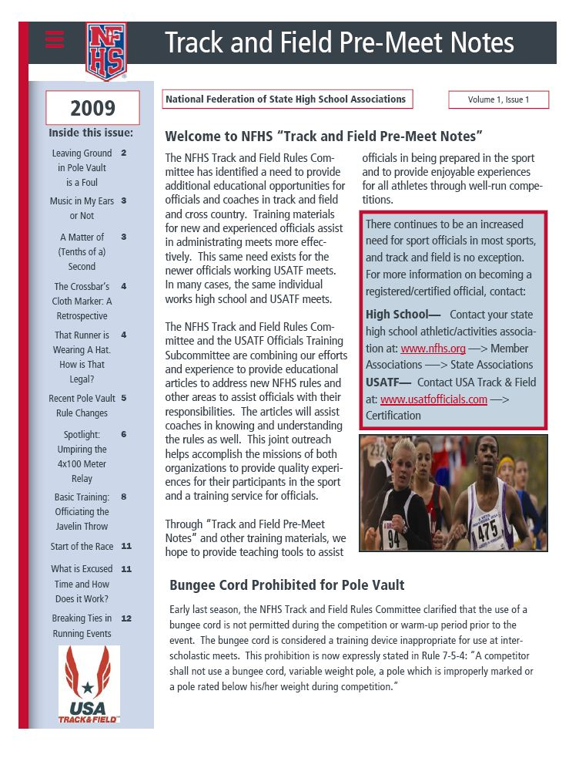
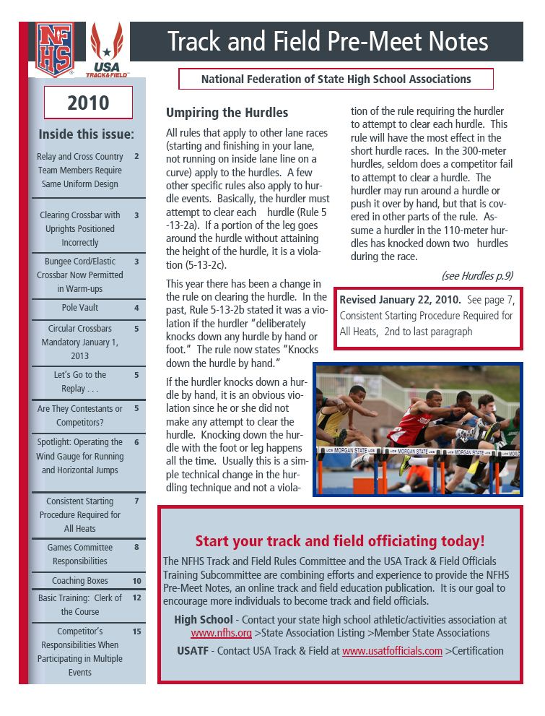
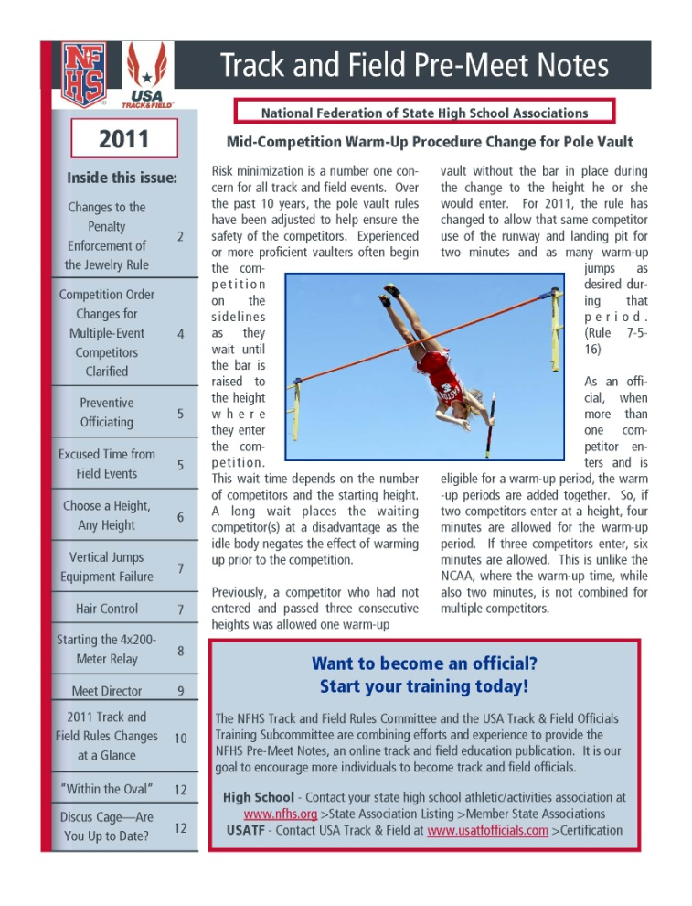
NFHS Track and Field Pre-Meet Notes
NFHS Track and Field
Pre-Meet Notes
will be available online in early December 2011 at http://www.nfhs.org/track.aspx
NFHS Track and Field Pre-Meet Notes is made possible through the cooperative efforts of the NFHS Track and Field Rules Committee and USA Track and Field Officials Training Subcommittee

Slide 18
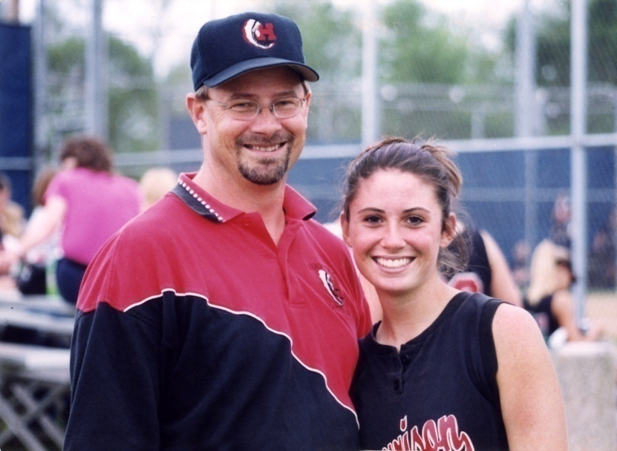
The Role of the Parent in Sports www.nfhslearn.com
Designed for parents
Explains what interscholastic
athletics are about
Provides information and resources
to ensure their child has a positive
educational sport experience
Includes units on:
What interscholastic athletics are about
What You and Your Child Want Out of School Sports
Having a Successful Educational Sport Experience
Making the Call
Plan for Improvement
Keeping Perspective
(Research based content provided by MSU Institute of Study of Youth Sport)
Notes:
The Role of the Parent in Sports online course is offered at NO COST by the NFHS.
All you need to do is register on www.nfhslearn.com. It is quick, easy and takes about 20-25 minutes to complete.
Any parent or interested individual may take the course.
Take a look and share this information with others.

Slide 19
Concussion in Sports www.nfhslearn.com
Notes:
To assist in concussion management education, the NFHS, at no cost, offers Concussion in Sports - What You Need to Know.
The only requirement is registering on www.nfhslearn.com, which is quick and easy.
This 20 minute course is designed for coaches, officials, parents, administrators and students to learn how to recognize the signs and symptoms of concussions and a step-wise process to return to the sport.
Check it out and share this information with others. Over 200,000 courses have already been delivered!

Slide 20
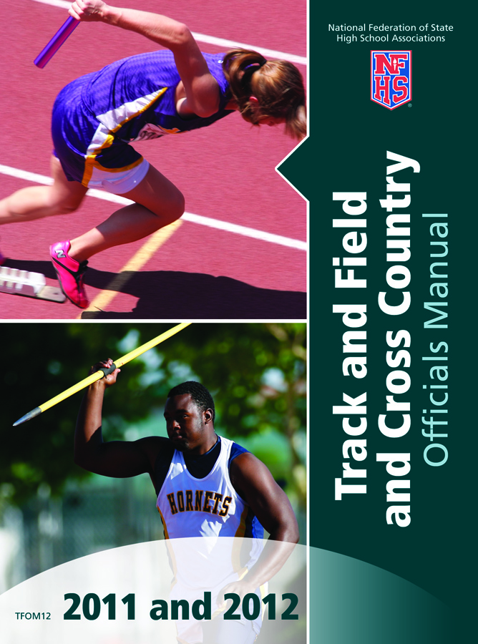
NFHS Track and Field and Cross Country Publications
The Rules Book, Case Book and Officials Manual can be ordered:
Online at: www.nfhs.com
By calling:
1-800-776-3462
By contacting the PIAA Office.

